Slide 1

Databases
By: Manoja Weerasekara

Slide 2
Lecture-08 Normalization for Relational Databases

Slide 3
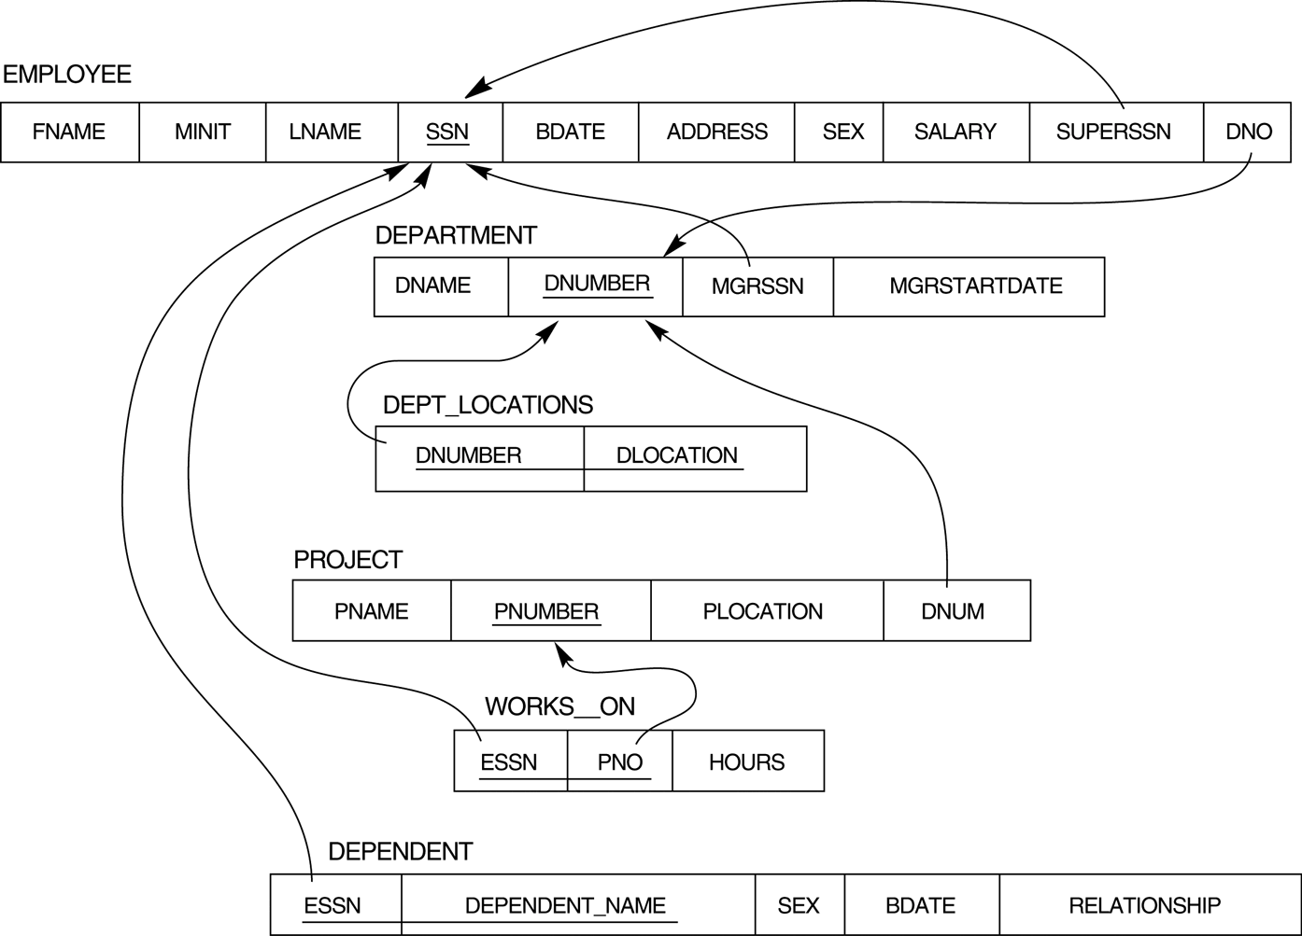

Slide 4
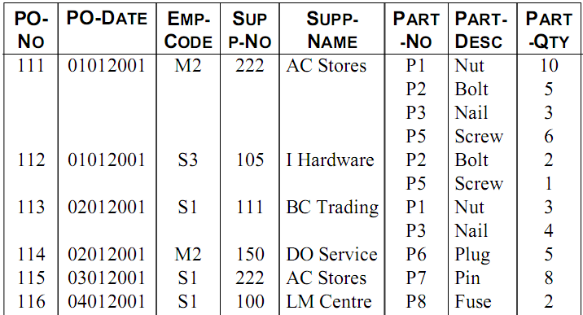
Purchase Order Relation

Slide 5
WHAT?
WHY?
HOW?

Slide 6
WHAT IS NORMALIZATION

Slide 7
Normalization of Relations
Normalization: The process of decomposing unsatisfactory "bad" relations by breaking up their attributes into smaller relations

Slide 8
WHY NORMALIZE

Slide 9
The main goal of Database Normalization is to restructure the logical data model of a database to:
Eliminate redundancy
Organize data efficiently
Reduce the potential for data anomalies.

Slide 10
INSERT/UPDATE/DELETE
StudentID | StudentName | Faculty | FacultyDean | FacultyContactNo
100 | Mala | Computing | Prof. Perera | 5446000
200 | Saman | MGT | Prof. Silva | 5445000
300 | Rani | Computing | Prof. Perera | 5446000
400 | Raja | Computing | Prof. Perera | 5446000
500 | Sunil | Computing | Prof. Perera | 5446000
600 | Kamal | MGT | Prof. Silva | 5445000

Slide 11
Student_Details
StudentID | StudentName | Faculty
100 | Mala | Computing
200 | Saman | MGT
300 | Rani | Computing
400 | Raja | Computing
500 | Sunil | Computing
600 | Kamal | MGT
Faculty_Details
Faculty | FacultyDean | FacultyContactNo
Computing | Prof. Perera | 5446000
MGT | Prof. Silva | 5445000

Slide 12
HOW TO NORMALIZE

Slide 13
There is a sequence to normal forms: 1NF is considered the weakest, 2NF is stronger than 1NF,
3NF is stronger than 2NF, and BCNF is considered the strongest

Slide 14
1NF
a relation in BCNF, is also in 3NF
2NF
a relation in 3NF is also in 2NF
a relation in 2NF is also in 1NF
3NF
BCNF

Slide 15
Recap
1NF: Disallows composite attributes, multivalued attributes, and nested relations
2NF: Remove partial dependencies
3NF: Remove transitive dependencies
*BCNF: Higher and strict version of 3NF
3 NF
1NF
0 NF
2 NF

Slide 16
Data anomalies are inconsistencies in the data stored in a database as a result of an operation such as update, insertion, and/or deletion.
Such inconsistencies may arise when have a particular record stored in multiple locations and not all of the copies are updated.

Slide 17
The benefit of higher normal forms is that update semantics for the affected data are simplified.
This means that applications required to maintain the database are simpler.
A design that has a lower normal form than another design has more redundancy. Uncontrolled redundancy can lead to data integrity problems.

Slide 18
First Normal Form
Disallows composite attributes, multivalued attributes, and nested relations; attributes whose values for an individual tuple are non-atomic.

Slide 19
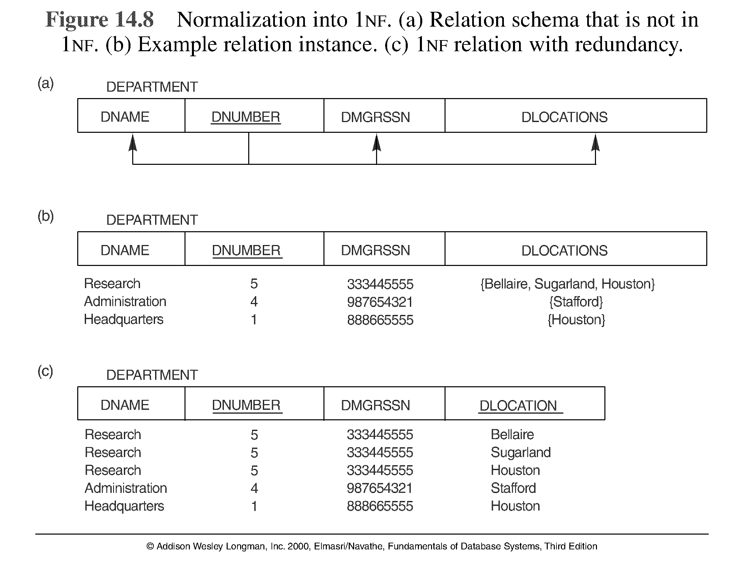
Normalization into 1NF

Slide 20
EmpNum | EmpPhone | EmpDegrees
123 | 233-9876
333 | 233-1231 | BA, BSc, PhD
679 | 233-1231 | BSc, MSc

Slide 21
EmpNum | EmpPhone | EmpDegrees
123 | 233-9876
333 | 233-1231 | BA, BSc, PhD
679 | 233-1231 | BSc, MSc
EmpNum | EmpPhone | EmpDegree
123 | 233-9876
333 | 233-1231 | BA
333 | 233-1231 | BSc
333 | 233-1231 | phD
679 | 233-1231 | MSc
679 | 233-1231 | BSc

Slide 22
EmpNum | EmpPhone | EmpDegrees
123 | 233-9876
333 | 233-1231 | BA, BSc, PhD
679 | 233-1231 | BSc, MSc
EmpNum | EmpPhone
123 | 233-9876
333 | 233-1231
679 | 233-1231
EmpNum | EmpDegree
123
333 | BA
333 | BSc
333 | phD
679 | MSc
679 | BSc

Slide 23
Functional Dependency
Uses the concepts of FDs, primary key
Definitions:
Prime attribute/Key attribute - attribute that is member of the primary key K
Full functional dependency - a FD Y -> Z where removal of any attribute from Y means the FD does not hold any more

Slide 24
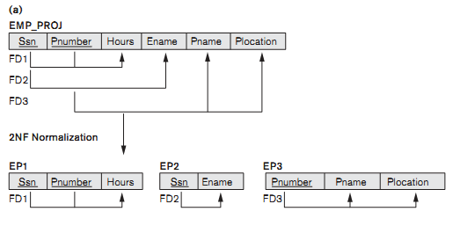
Functional Dependency
FD1: Full Functional Dependency
FD2/FD3: Partial Dependency
FD4: Transitive Dependency
FD4

Slide 25
Second Normal Form
A relation schema R is in second normal form (2NF) if every non-prime attribute A in R is fully functionally dependent on the primary key. (That is, we don’t have any partial functional dependency.)
R can be decomposed into 2NF relations via the process of 2NF normalization

Slide 26
Normalizing into 2NF

Slide 27
InvNum, LineNum
InvNum | LineNum | ProdNum | Qty | InvDate
ProdNum, Qty
InvNum
InvDate
Show the dependencies.
Normalize your relation to the highest normal form

Slide 28
InvNum, LineNum
Invoice:
InvNum | LineNum | ProdNum | Qty | InvDate
ProdNum, Qty
InvNum
InvDate

Slide 29
InvNum, LineNum
Invoice:
InvNum | LineNum | ProdNum | Qty | InvDate
ProdNum, Qty
FFD
InvNum
InvDate
PD
Table is in ………………
So we will bring this to ………………
HOW?

Slide 30
InvNum, LineNum
Invoice:
InvNum | LineNum | ProdNum | Qty | InvDate
ProdNum, Qty
FFD
InvNum
InvDate
PD
Invoice_1
InvNum | LineNum | ProdNum | Qty
Invoice_2
InvNum | InvDate

Slide 31
Third Normal Form
A relation schema R is in third normal form (3NF) if it is in 2NF and no non-prime attribute A in R is transitively dependent on the primary key
R can be decomposed into 3NF relations via the process of 3NF normalization
NOTE:
In X -> Y and Y -> Z, with X as the primary key, we consider this a problem only if Y is not a candidate key. When Y is a candidate key, there is no problem with the transitive dependency .
E.g., Consider EMP (SSN, Emp#, Salary ).
Here, SSN -> Emp# -> Salary and Emp# is a candidate key.

Slide 32
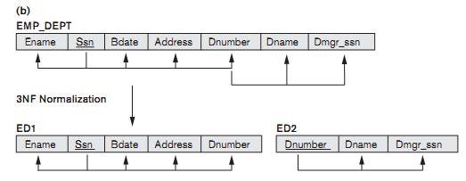
Normalizing into 3NF
Table is in ………………
So we will bring this to ………………
HOW?

Slide 33
Recap
1NF: Disallows composite attributes, multivalued attributes, and nested relations
2NF: Remove partial dependencies
3NF: Remove transitive dependencies
BCNF: Higher and strict version of 3NF

Slide 34
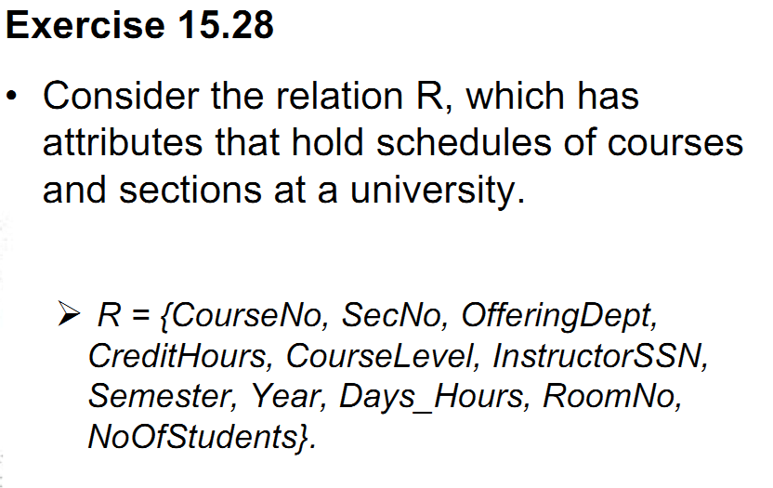
Case Study- Home Work

Slide 35
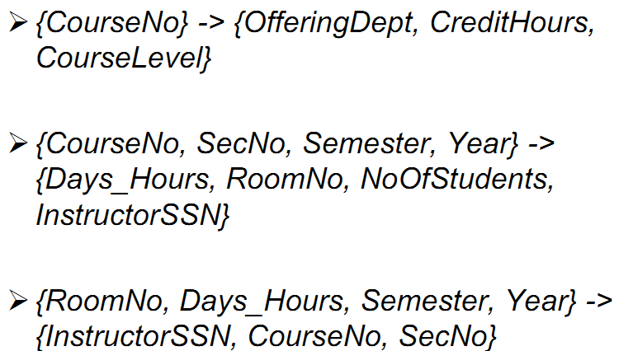
Suppose that the following FDs hold on R
How would you normalize this relation?

Slide 36
Thank You

